Slide 1
THE NUMBER ONE WORLDWIDE IN THE MEDICAL AIDS SECTOR

Slide 2
THE MEETING PLACE FOR THE MODERN MEDICAL AIDS INDUSTRY
OTWorld 2024 combines a top-class world congress with the world’s leading international trade show and sets new standards for modern orthopaedic treatment and care.
20,000 visitors from 90 countries
500 international exhibitors
320 international speakers
2,500 congress participants

Slide 3
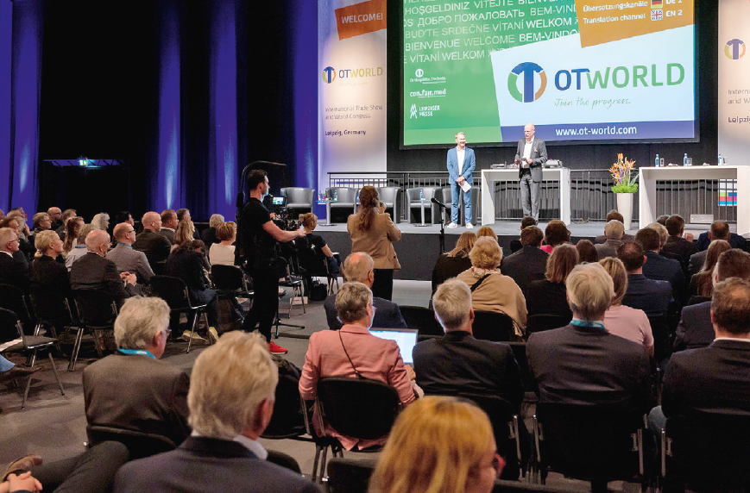
World Congress for O&P
Prosthetics, Orthotics
Orthopaedic footwear technology
Rehabilitation
Paediatric/adolescent orthopaedics and neuro-orthopaedics
Biomechanics
Materials research, production technology
Digitalization
Sports orthopaedics/Parasport
Physiotherapy
Ambient assisted living
Learning systems, Robotics
CPD credits and certification for
prosthetists and orthotists,
orthopaedic footwear technicians
physicians and physiotherapists
Congress languages English and German

Slide 4
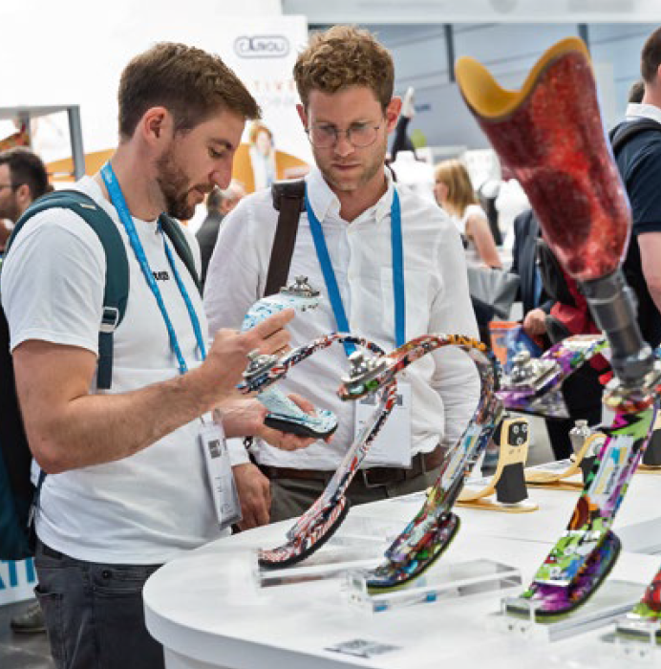
International Trade Show
Global market overview in prosthetics, orthotics, orthopaedic footwear technology, rehabilitation and compression therapy
Unique showcase of innovations in 3D printing and additive manufacturing
Concepts and medical aids in 9 treatment areas (mobility limitations, diabetes & vascular diseases, stroke, back, cancer, sports injuries, prevention, etc.)

Slide 5
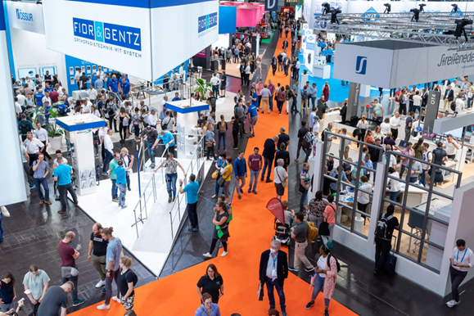
OTWorld 2024 – Secure your ticket NOW
Join the progress!
Secure your ticket by 31 March 2024 and benefit from the Early Bird discount.
NEW: The entire congress programme is available with the OTWorld complete ticket!
NEW: Attendance at all workshops is included in the OTWorld trade show ticket.

Slide 6
We look forward to seeing you!
We are part of OTWorld.friends, a network of associations and professional societies around the world that support the knowledge transfer at OTWorld.
We look forward to seeing you in Leipzig, Germany, 14 - 17 May!

